Slide 1
Floriculture Tools ID
FFA

Slide 2
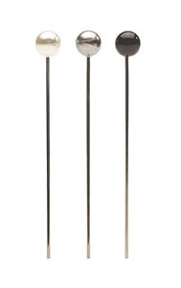
Boutonniere Pin

Slide 3
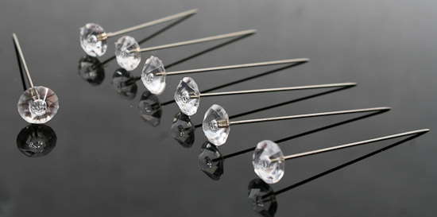
Corsage Pin

Slide 4
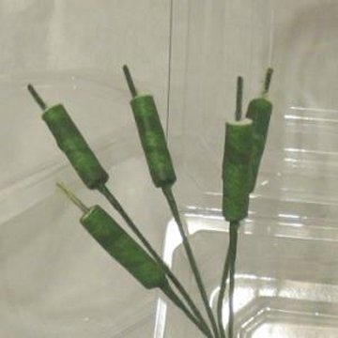
Corsage Stem

Slide 5
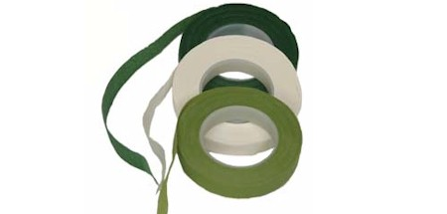
Corsage Tape

Slide 6
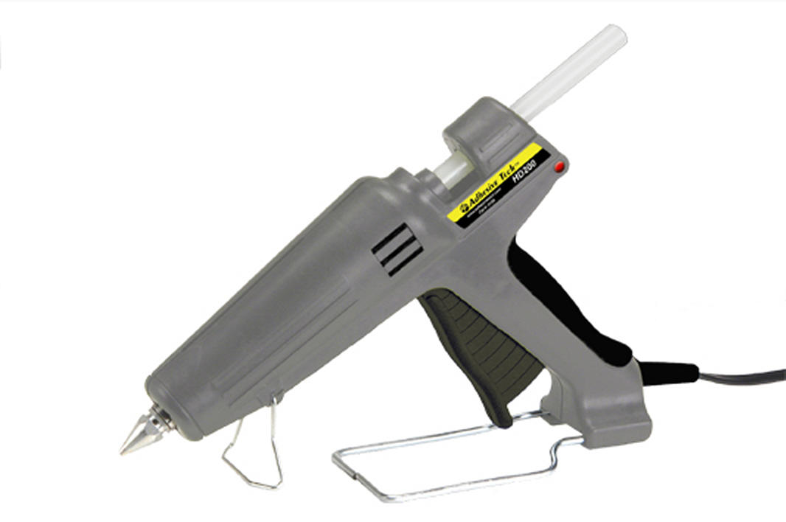
Glue Gun

Slide 7
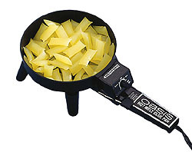
Glue Pan

Slide 8
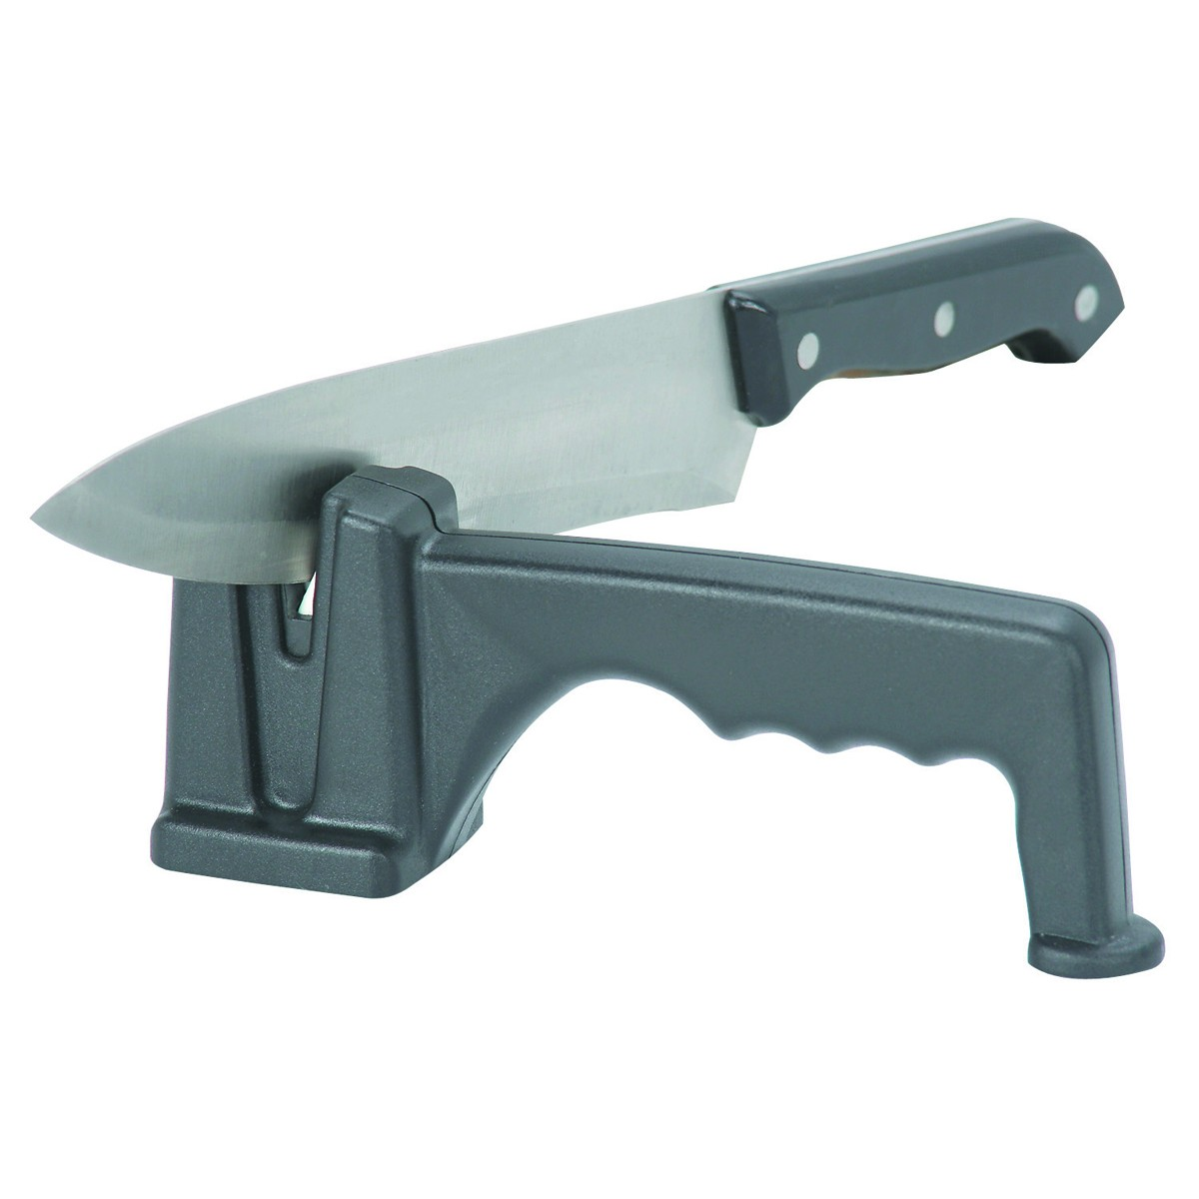
Knife Sharpener

Slide 9
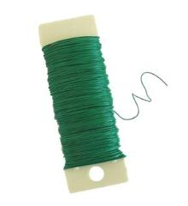
Paddle Wire

Slide 10
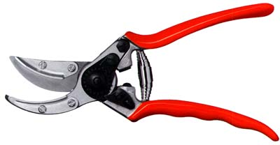
Pruner

Slide 11
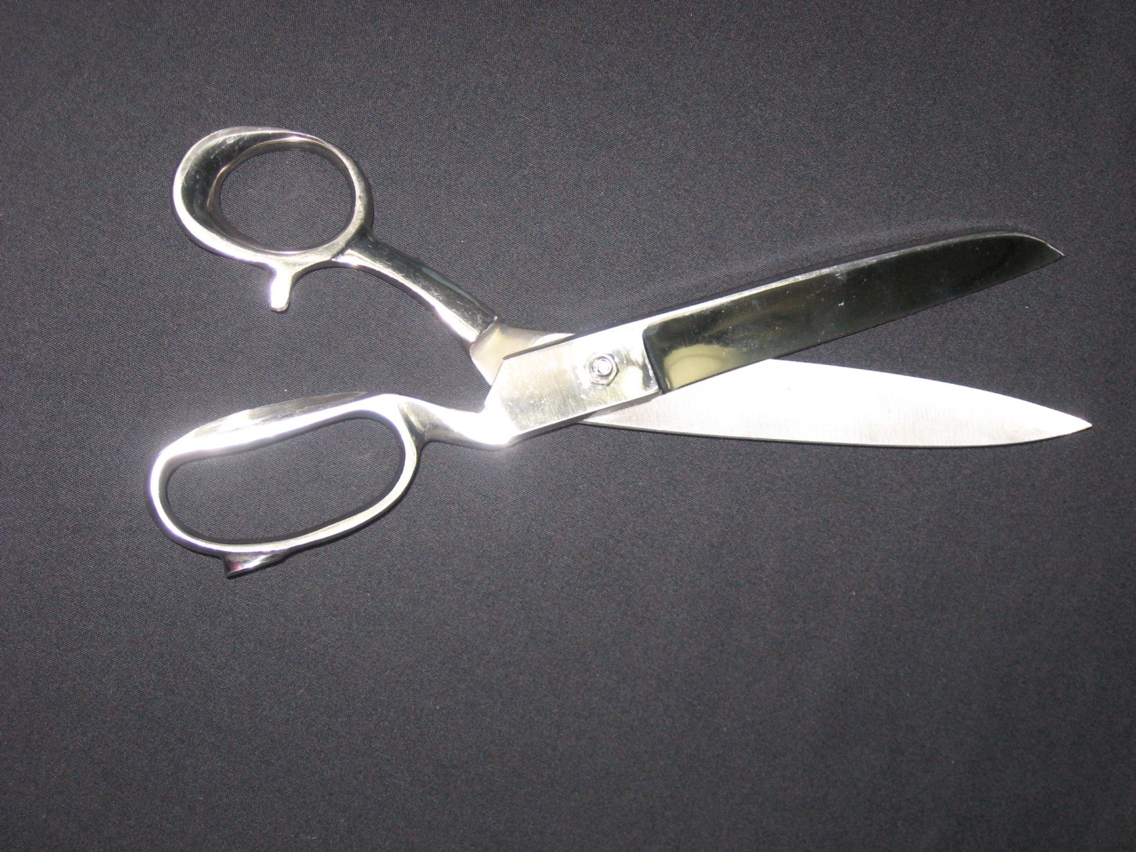
Ribbon Scissor

Slide 12
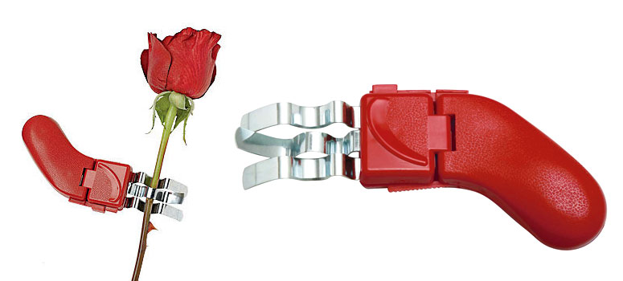
Rose Stripper

Slide 13
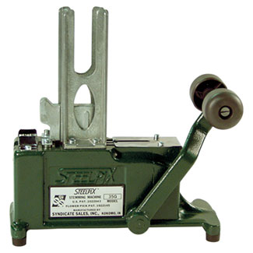
Steel Pick Machine

Slide 14
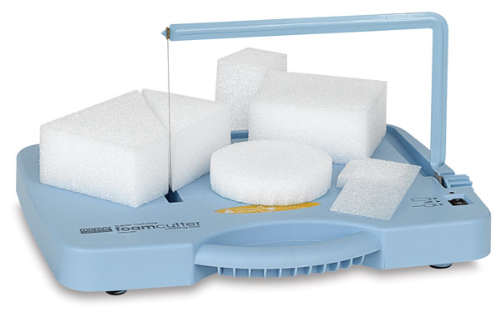
Styrofoam Cutter

Slide 15
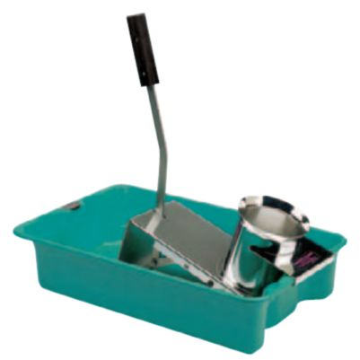
Underwater Cutter

Slide 16
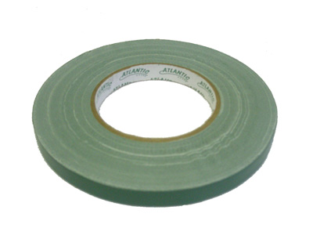
Waterproof Tape

Slide 17
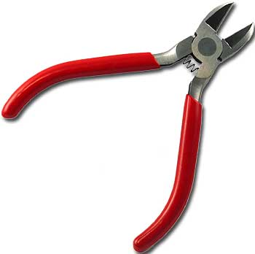
Wire Cutters

Slide 18
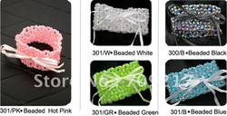
Wristlet

