Slide 1
Flower I.D.

Slide 2
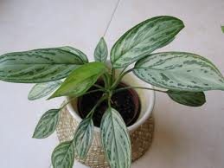
Aglaonema commutatum cv. / Aglaonema

Slide 3
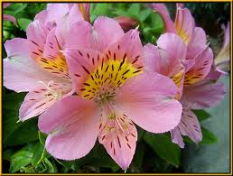
Alstroemeria aurantica/ peruvian lily

Slide 4
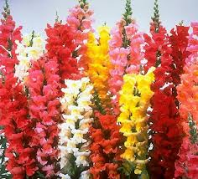
Anthirrhinum majus cv./ snapdragon

Slide 5
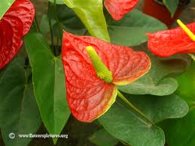
Anthurium x andraeanum/ Anthurium, Flamingo Lily

Slide 6
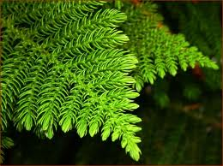
Araucaria heterophylla/ Norfolk Island Pine

Slide 7
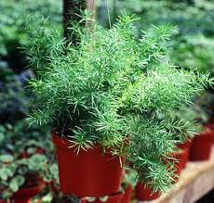
Asparagus densiflorous ‘Sprengeri’/ Sprengeri Fern

Slide 8
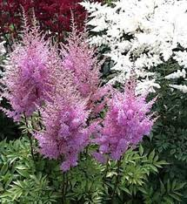
Astilbe hybrid cv. / Astilbe

Slide 9
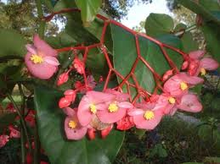
Begonia x semperflorens-cultorum / wax begonia

Slide 10
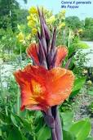
Canna x generalis cv. / Common Garden Canna

Slide 11
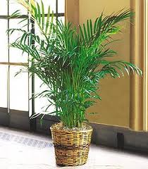
Chamaedorea elgans / Parlor Palm

Slide 12
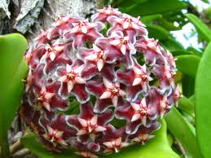
Chamelaucium uncinatum / Waxflower

Slide 13
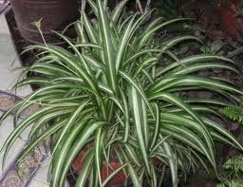
Chlorophytum commosum cv. / Spider Plant

Slide 14
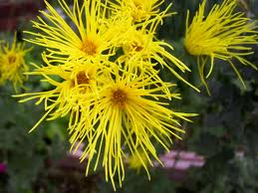
Chrysanthemum x morifolium cv. . Florist’s chrysanthemum

Slide 15
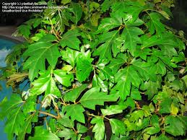
Cissus rhombifolia “mandaiana” / Grape Ivy

Slide 16
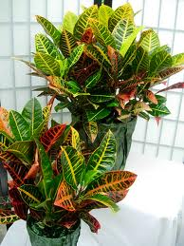
Codiaeum variegatum pictum cv. / Croton

Slide 17
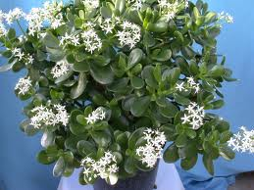
Crassula argentea / Jade Plant

Slide 18
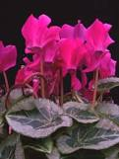
Cyclamen x persicum cv. / Florist’s Cyclamen

Slide 19
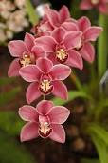
Cymbidium cv. / Cymbidium Orchid

Slide 20
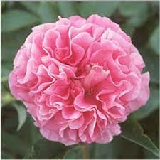
Dianthus caryophylus cv. / Carnation

Slide 21
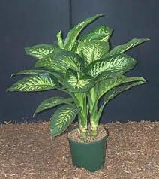
Dieffenbachia maculata cv. / Spotted Dumb cane

Slide 22
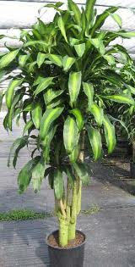
Dracaena fragrans ‘ Massangeana’ / Corn Plant Draceana

Slide 23
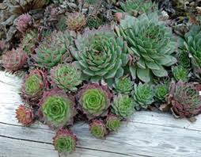
Echeveria cv. / Hens and Chickens

Slide 24
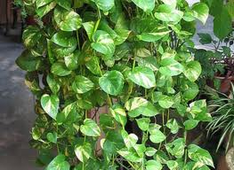
Epipremnum aureum / Golden Pothos, Devil’s Ivy

Slide 25
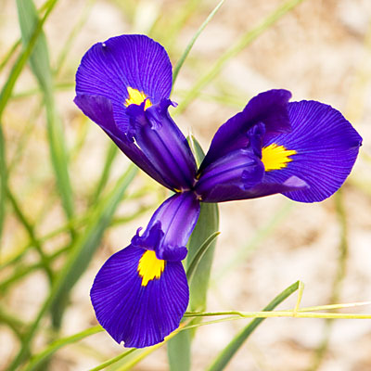
Iris x xiphium cv. / Dutch Iris

Slide 26
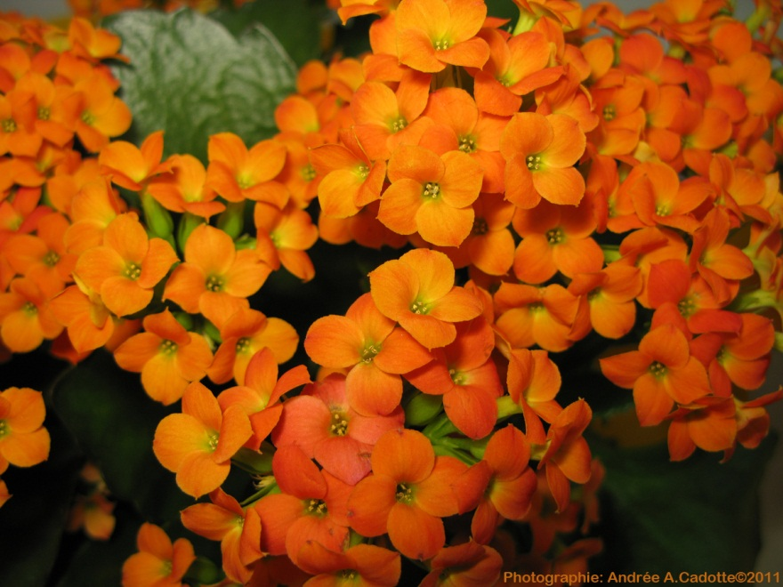
Kalanchoe x blossfeldiana cv. / Kalanchoe

Slide 27
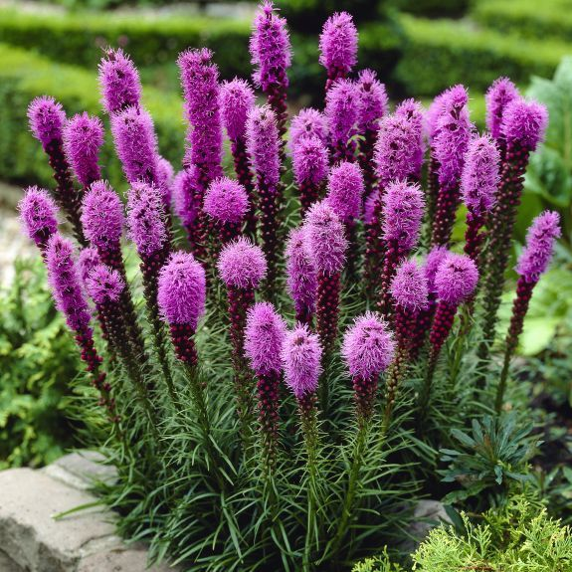
Liatris spicta/ Liatris

Slide 28
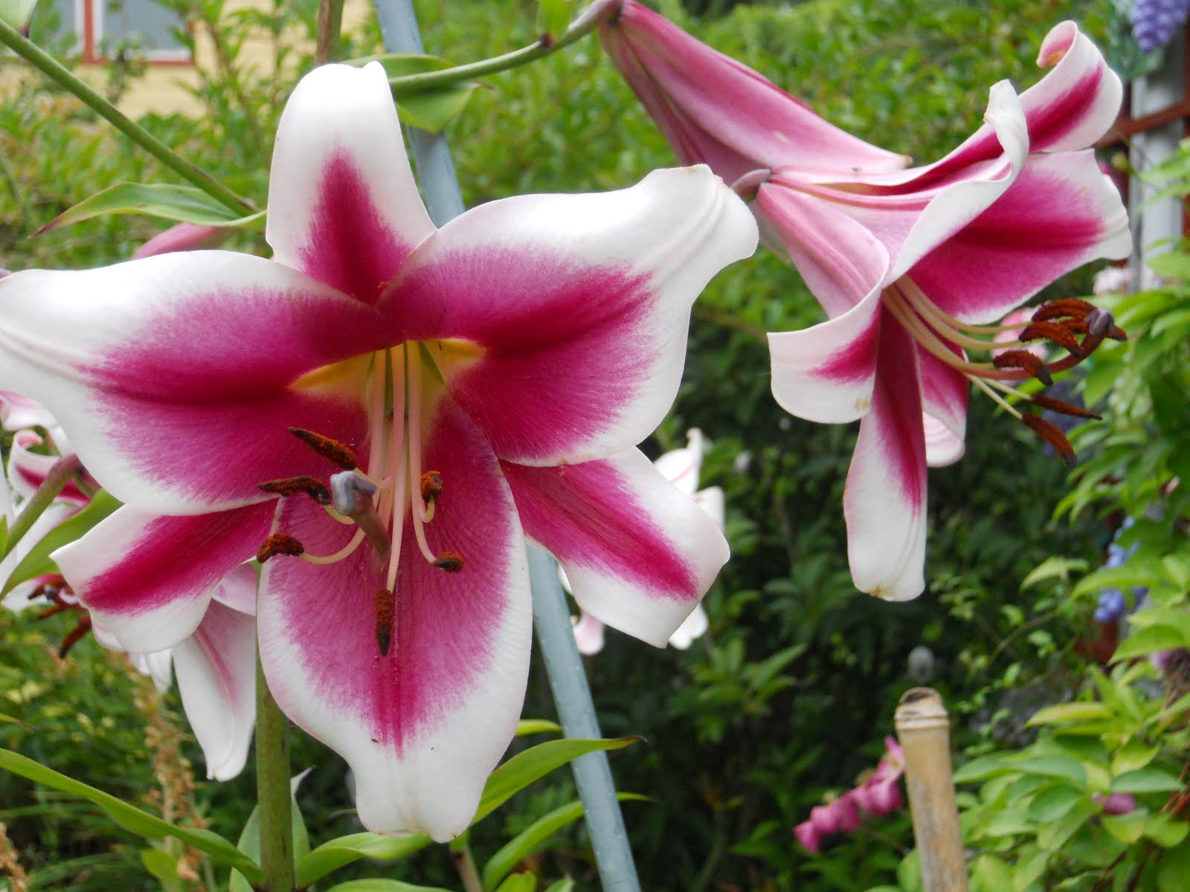
Lilium x hybridium cv. / Hybrid (garden) lily

Slide 29
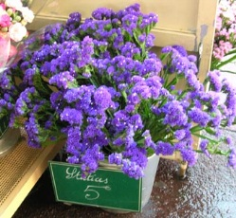
Limonium sinuatum / Statice

Slide 30
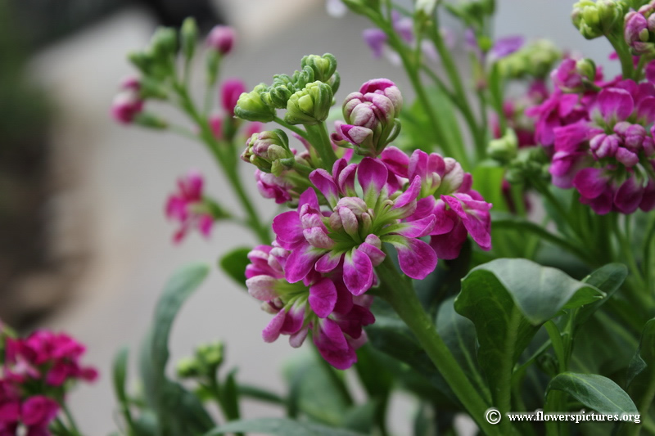
Matthiola incana cv. / Flowering stock

Slide 31
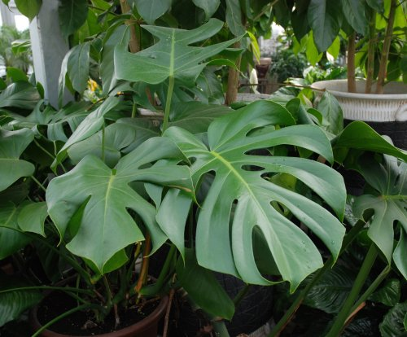
Monstera deliciosa / Cutleaf “Philendron”

Slide 32
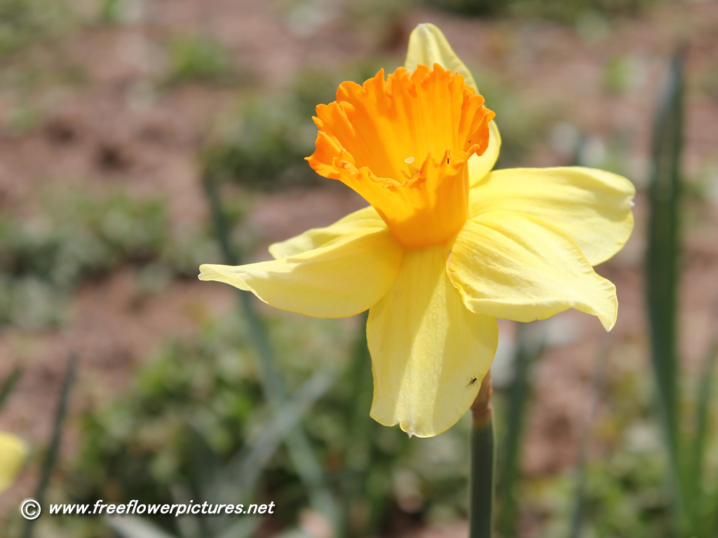
Narcissus pseudo-narcissus cv. / Daffodil

Slide 33
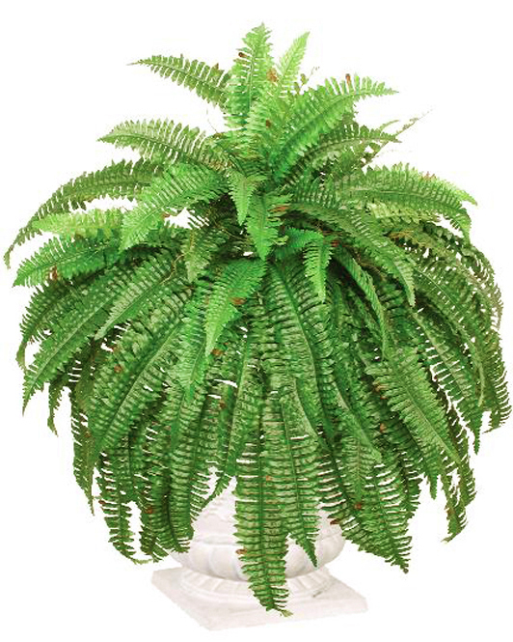
Nephrolepis exaltata cv. / Boston Fern

Slide 34
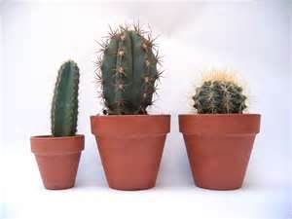
Opuntia tribe cv. / Cactus

Slide 35
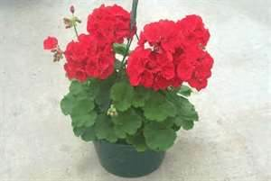
Pelargonium x hortorum cv. / Zonal geranium

Slide 36
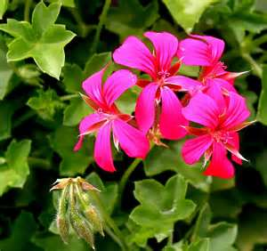
Pelargonium peltatum cv. / Ivy Geranium

Slide 37
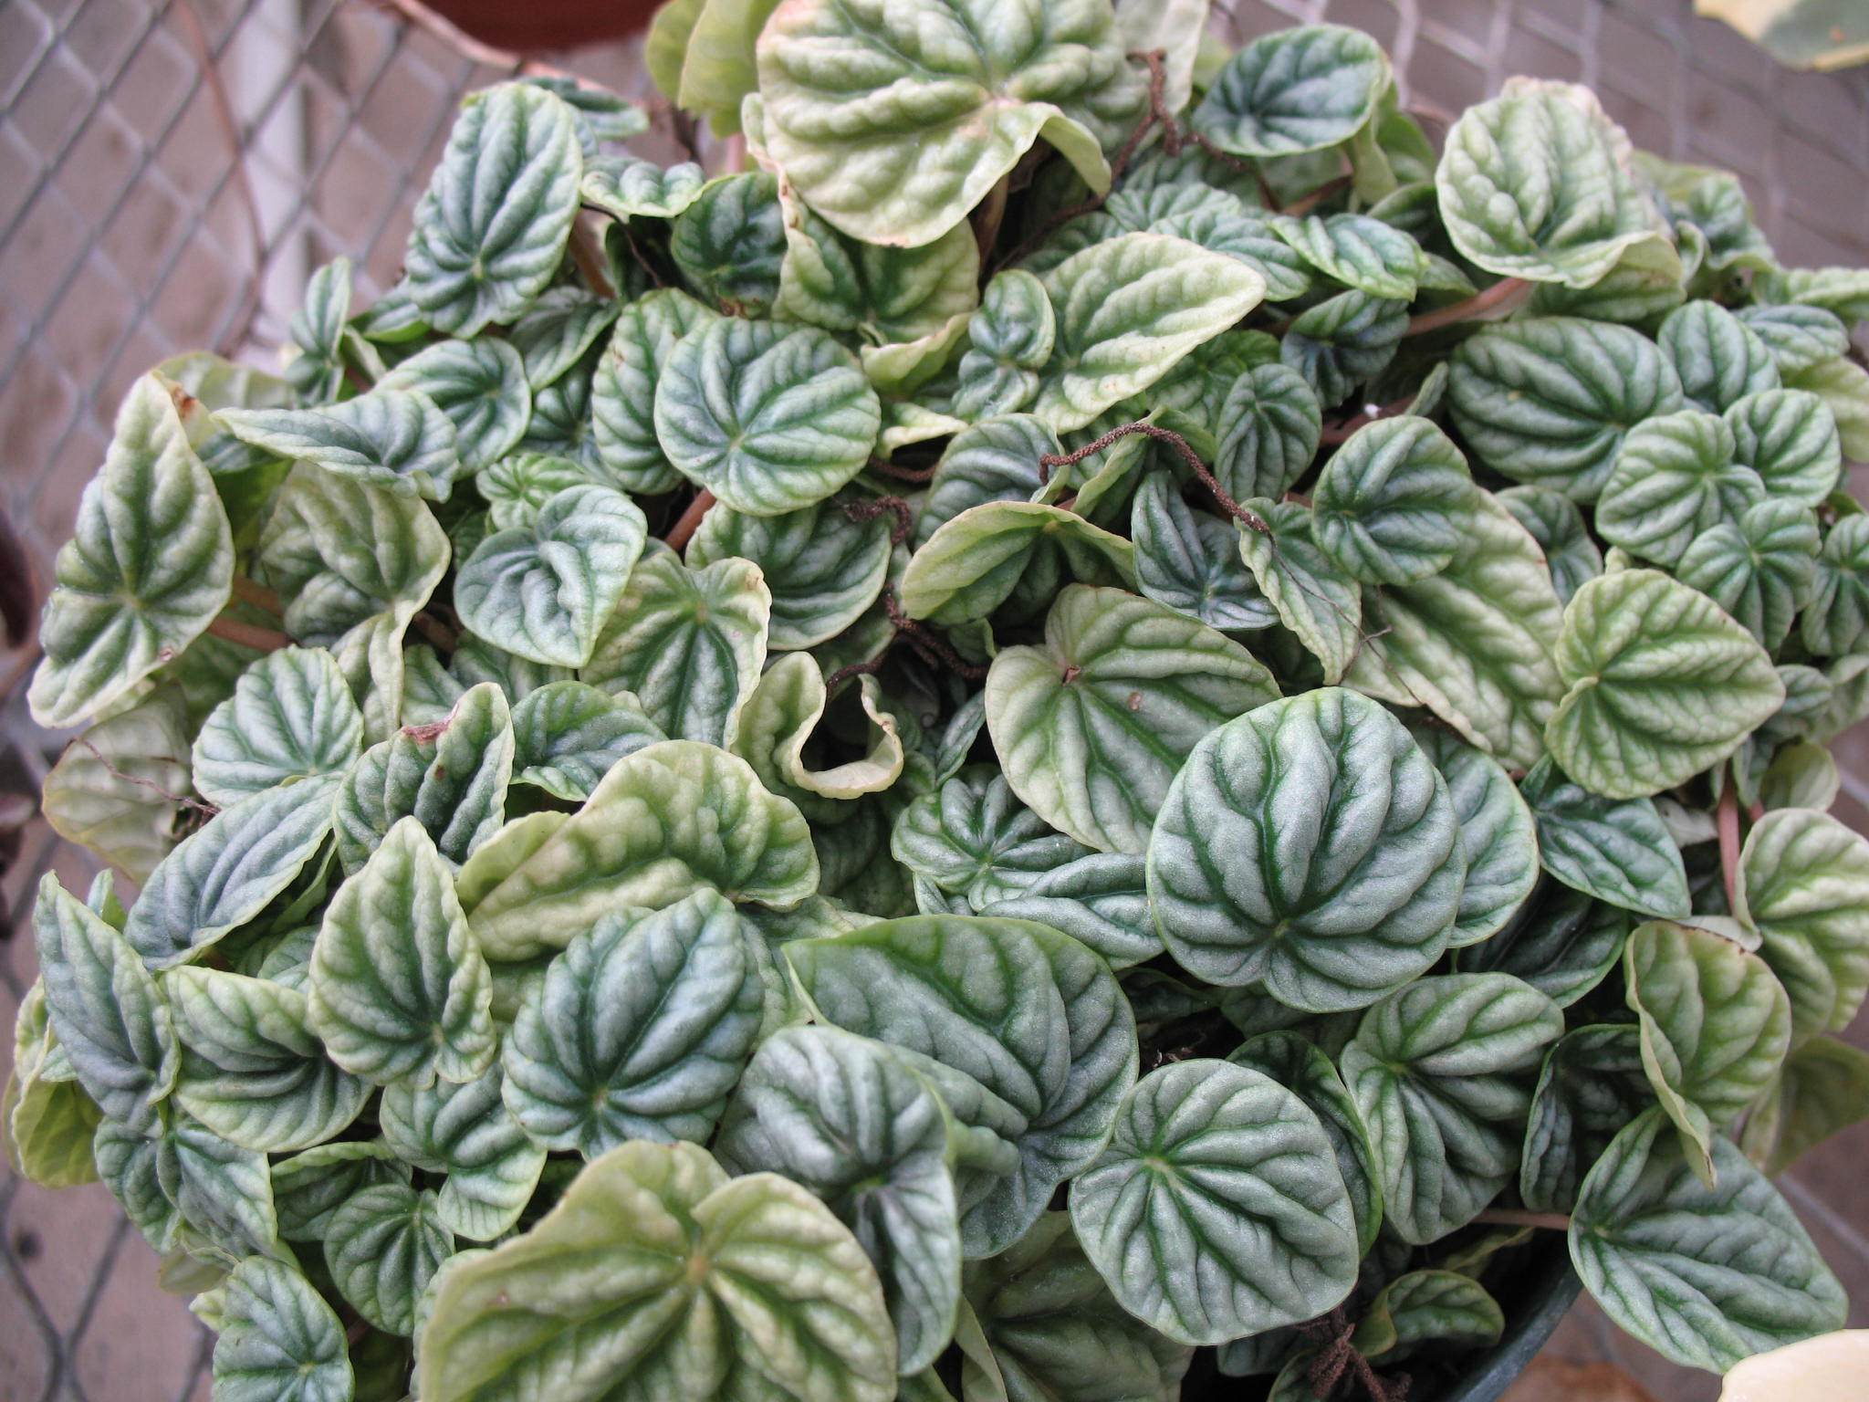
Peperonia caperata / Emerald Ripple Peperomia

Slide 38
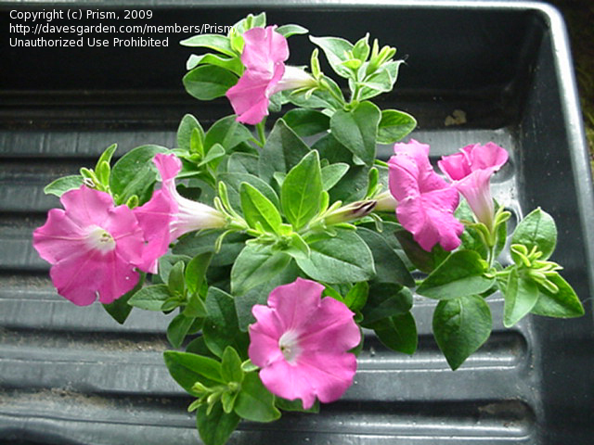
Petunia x hybrid cv. / Common Garden Petunia

Slide 39
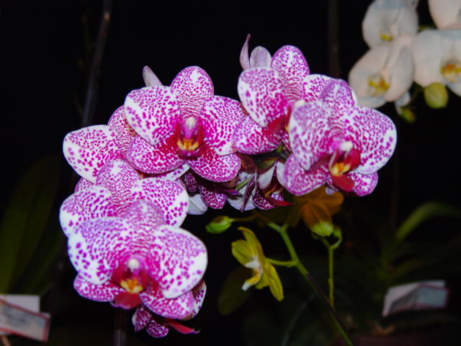
Phalaenopsis cv. / Phalaenopsis (Butterfly) Orchid

Slide 40
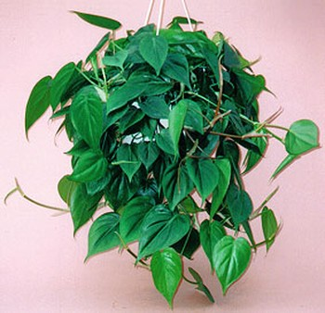
Philodendron oxycardium / Heartleaf Philodendron

Slide 41
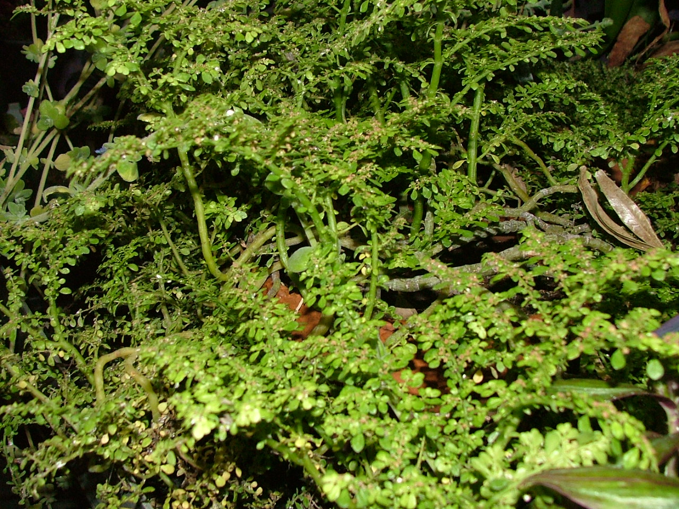
Pilea microphylla / Artillery Plant

Slide 42
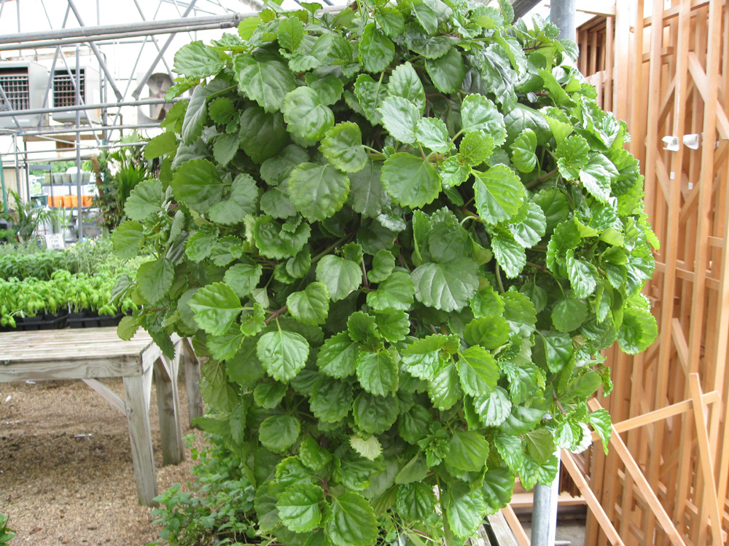
Plectranthus nummularis / Swedish Ivy

Slide 43
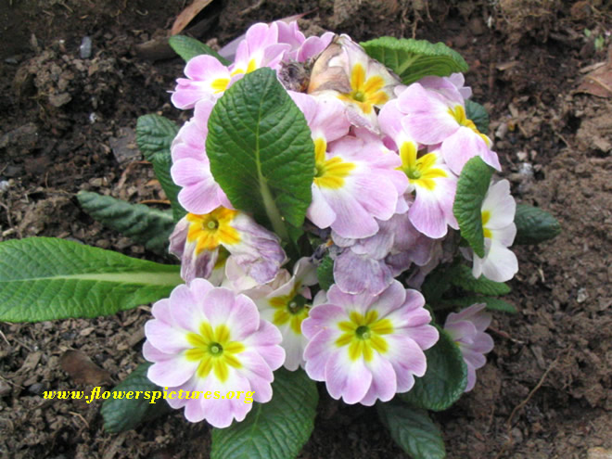
Primula x polyanthus cv. / Polyanthus (Primrose)

Slide 44
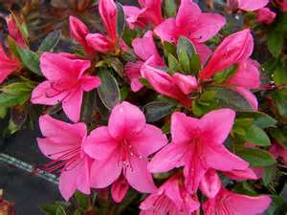
Rhododendron cv. / Azalea

Slide 45
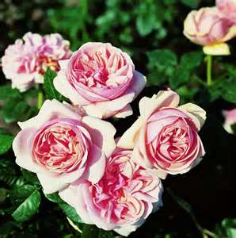
Rosa hybrid, Class Hybrid Tea cv. / Hybrid Tea Rose

Slide 46
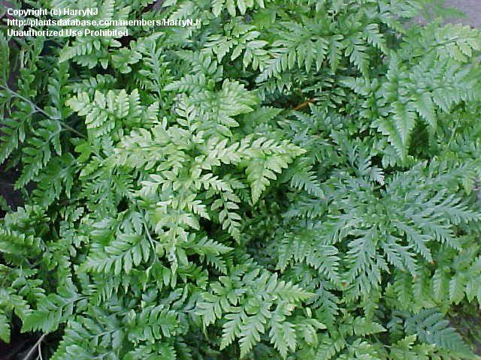
Rumohra adianthiformis / Leatherleaf Fern

Slide 47
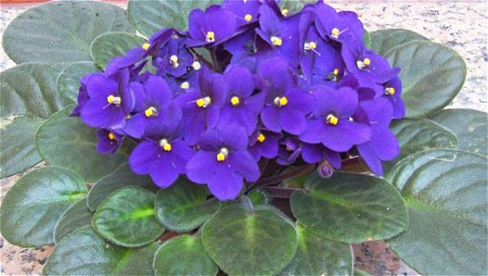
Saintpaulia ionantha cv. / African Violet

Slide 48
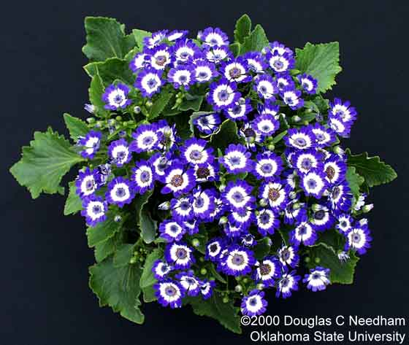
Senecio x hybridus cv. / Florist’s Cineraria

Slide 49
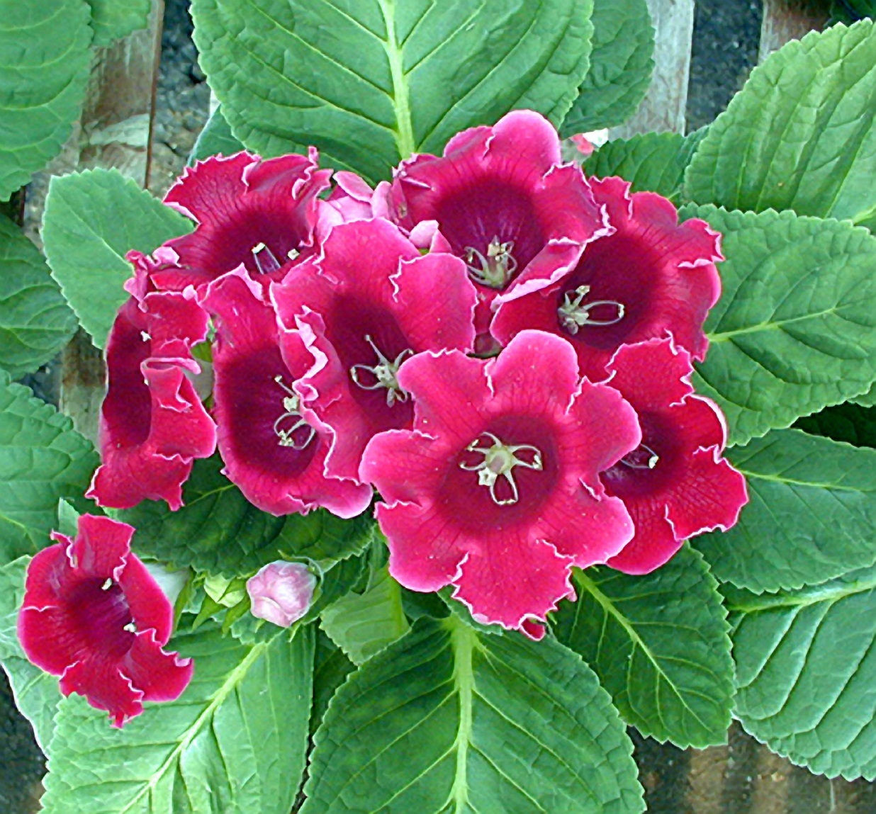
Sinningia speciosa Fyfiana Group cv. / Gloxinia

Slide 50
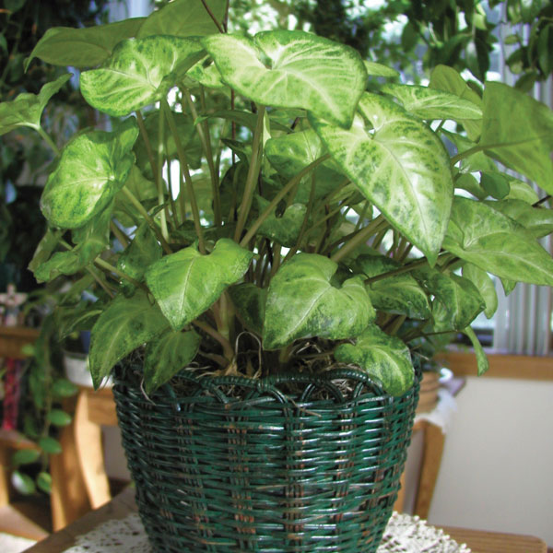
Syngonium podophyllum / Nephthytis

Slide 51
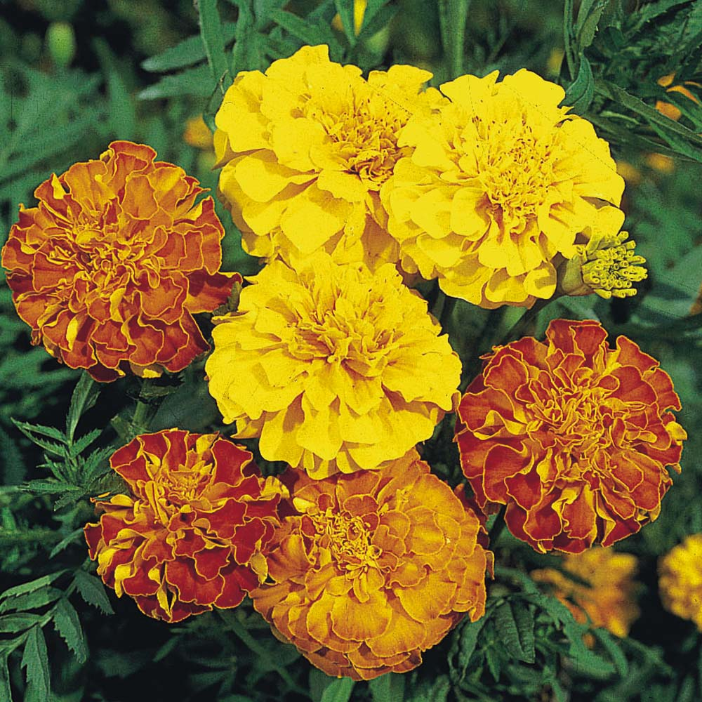
Tagetes species cv. / Marigold

Slide 52
Solenostemon hybrid / Coleus

Slide 53
Spathiphyllum clevelandi / White Anthurium, Peace Lily

Slide 54
Stephanotis floribunda / Stephanotis

Slide 55
Sterlitzia reginae / Bird-of-Paradise

Slide 56
Tulipa cv. / Tulip

Slide 57
Viola x wittrockiana cv. / (Garden) Pansy

Slide 58
Zebrina pendula cv. / Wandering Jew

