Slide 1
Nursery Landscape Tools

Slide 2
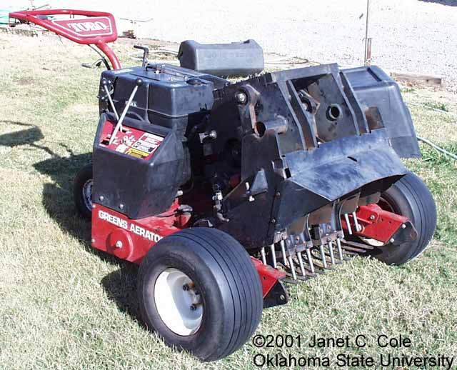
Aerifier

Slide 3
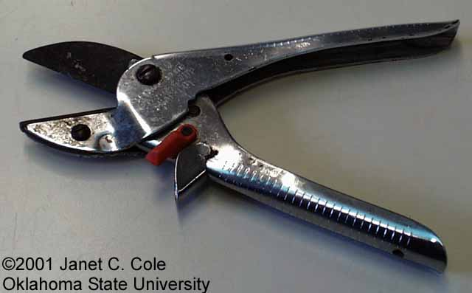
Anvil and Blade Pruner

Slide 4
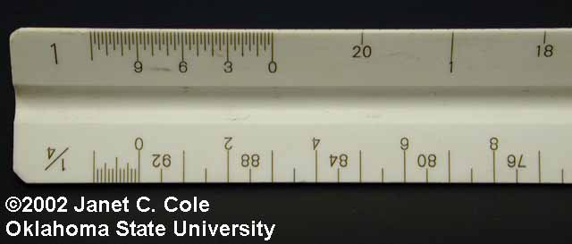
Architect’s Scale

Slide 5
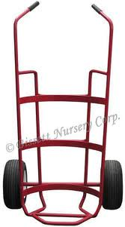
Ball Cart

Slide 6
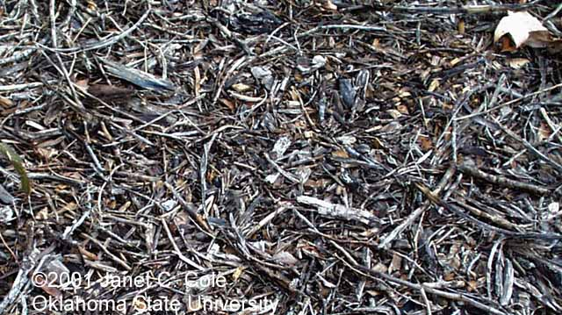
Bark Mulch

Slide 7
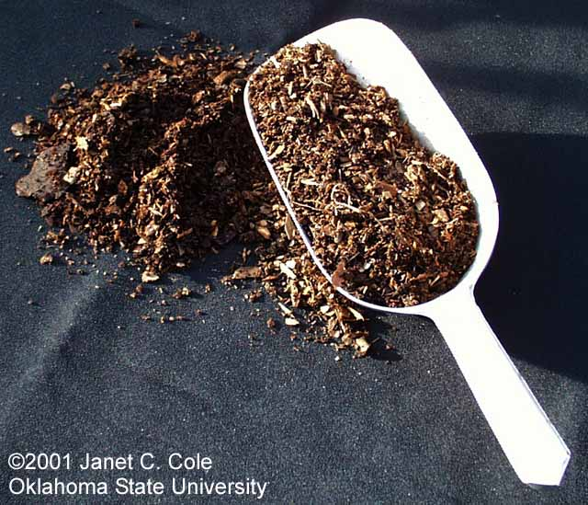
Bark Medium

Slide 8
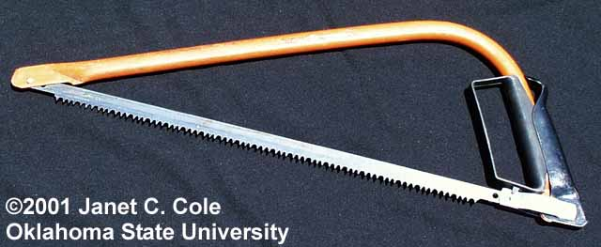
Bow Saw

Slide 9
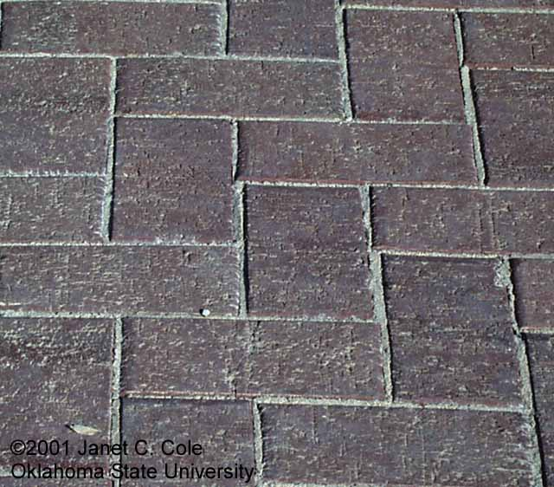
Brick Paver

Slide 10
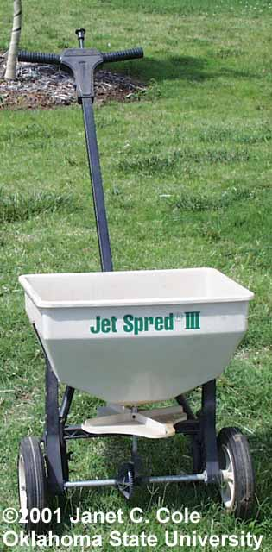
Broadcast (cyclone) Spreader

Slide 11
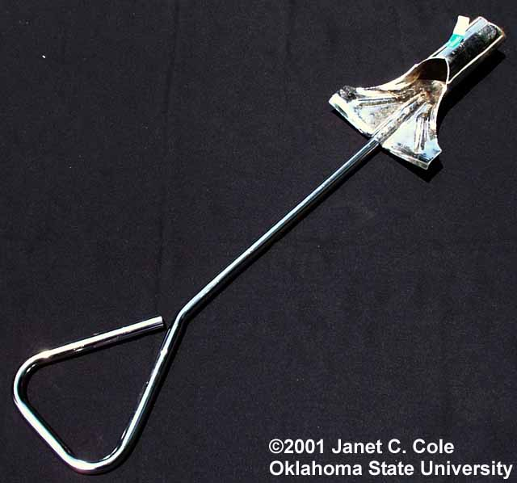
Bulb planter

Slide 12
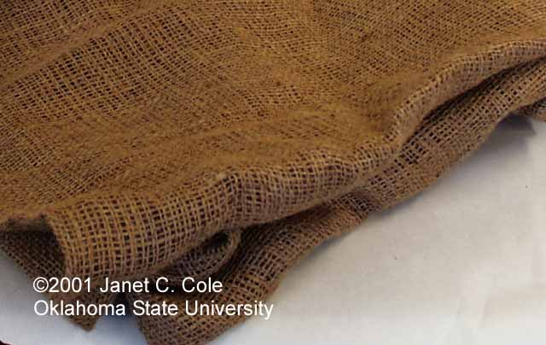
Burlap

Slide 13
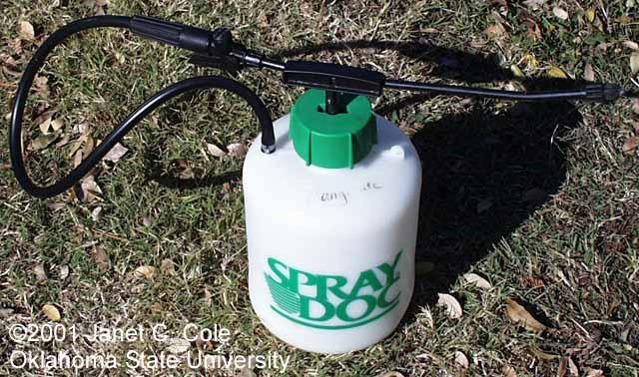
Compressed Air Sprayer

Slide 14
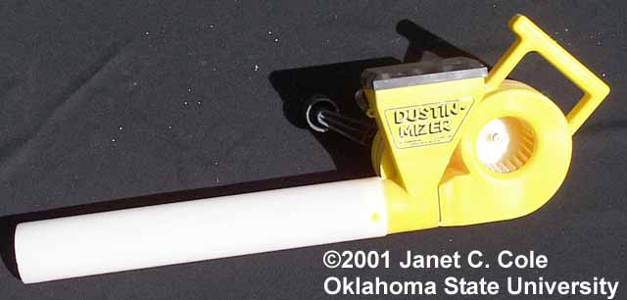
Duster

Slide 15
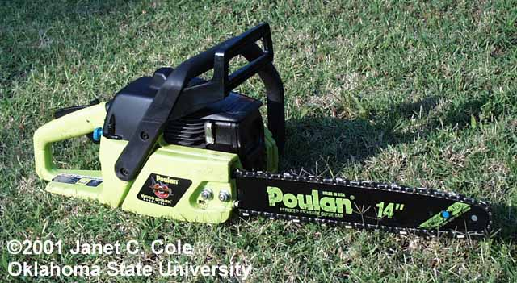
Chain Saw

Slide 16
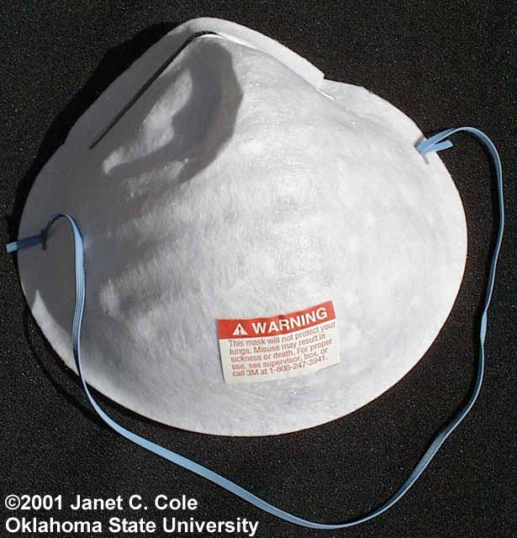
Dust Mask

Slide 17
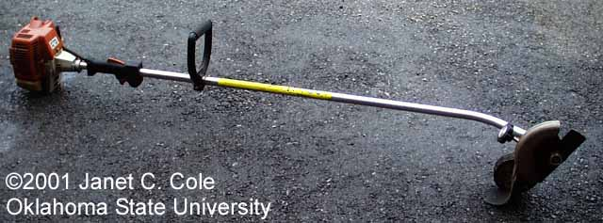
Edger

Slide 18
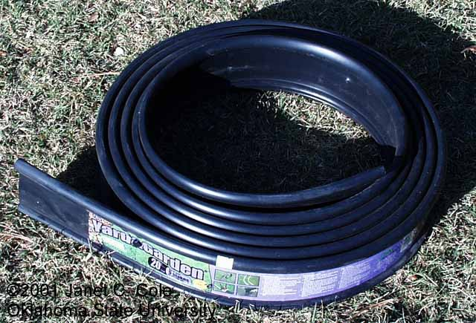
Edging

Slide 19
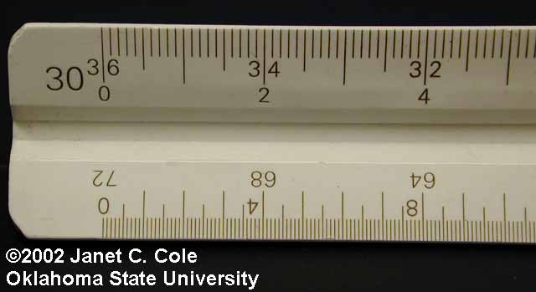
Engineer’s Scale

Slide 20
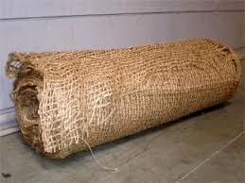
Erosion Netting

Slide 21
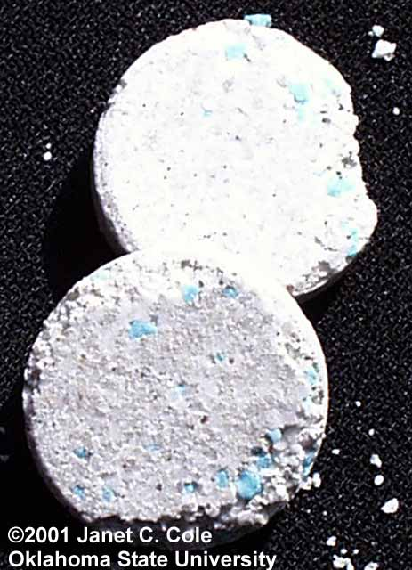
Fertilizer Tablet

Slide 22
Galvanized Pipe

Slide 23
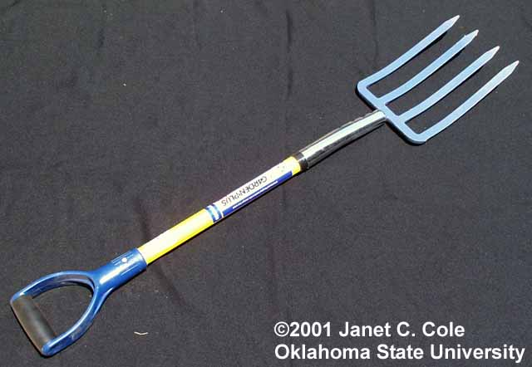
Garden (spading) fork

Slide 24
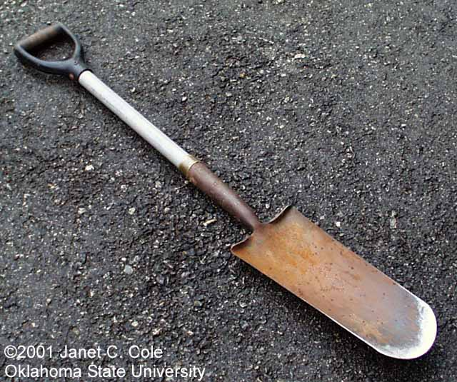
Garden spade

Slide 25
Garden Rake

Slide 26
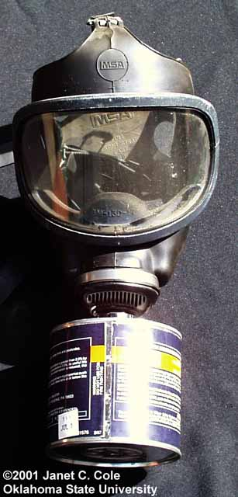
Gas Mask

Slide 27
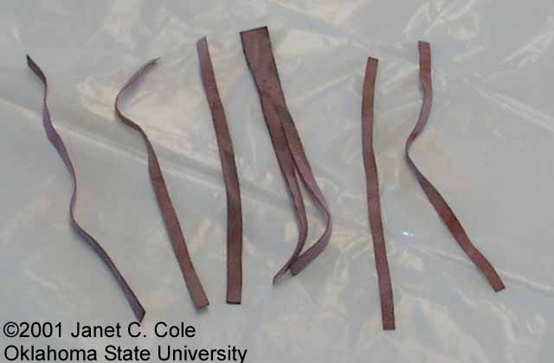
Grafting band

Slide 28
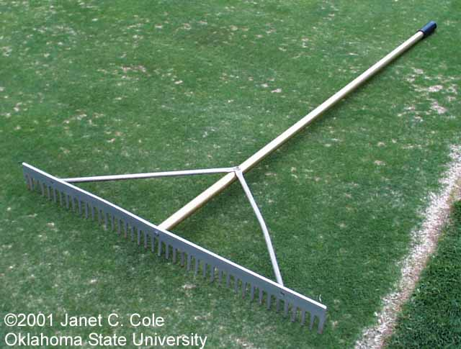
Grading rake (aluminum)

Slide 29
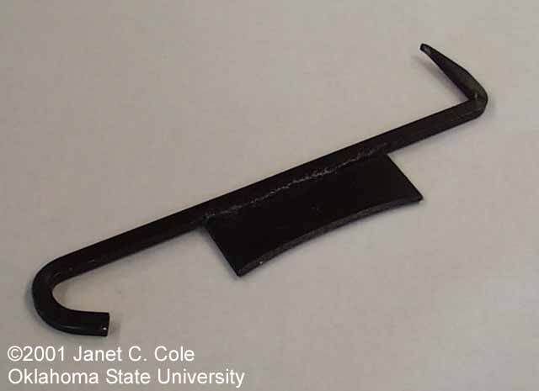
Grafting Tool

Slide 30
Granular Fertilizer

Slide 31
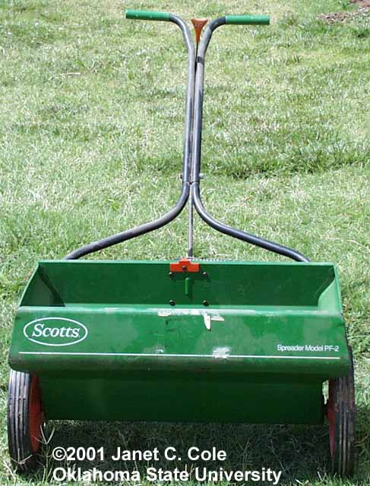
Gravity (drop) spreader

Slide 32
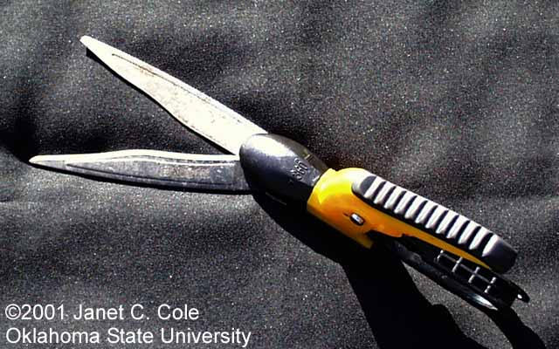
Grass shears

Slide 33
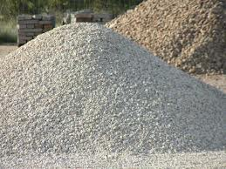
Ground Limestone

Slide 34
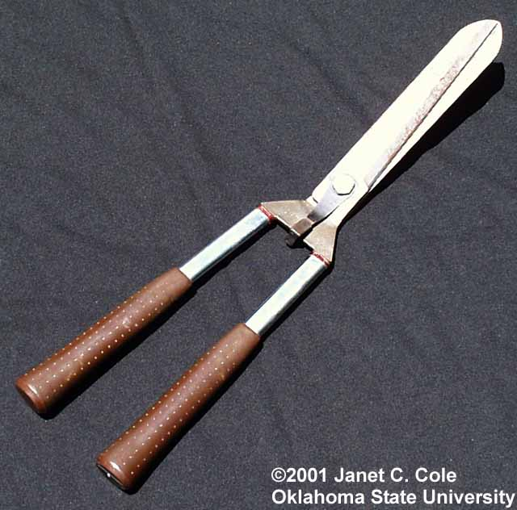
Hedge Shears

Slide 35
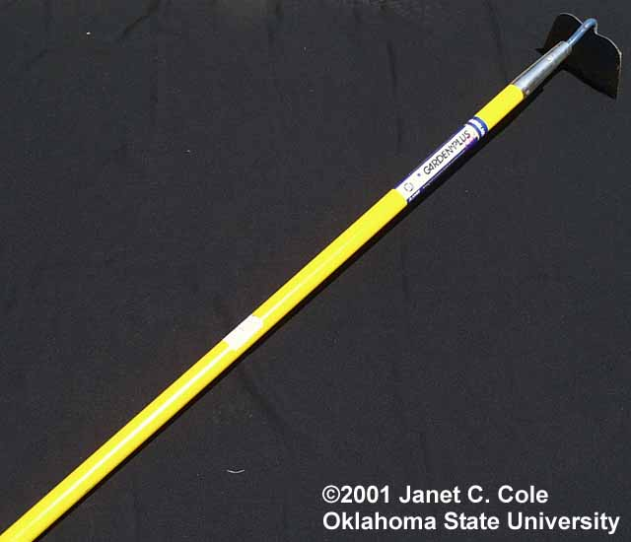
Hoe

Slide 36
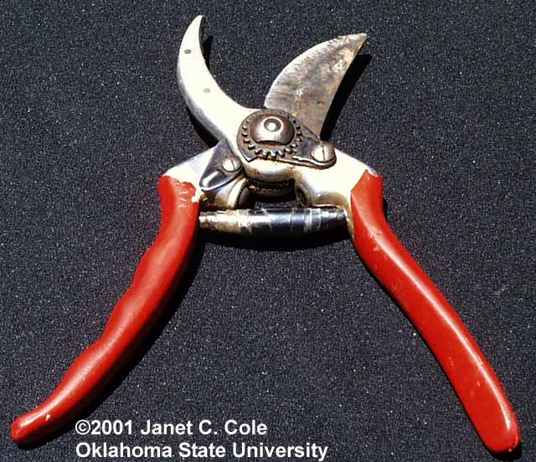
Hook and Blade Pruners

Slide 37
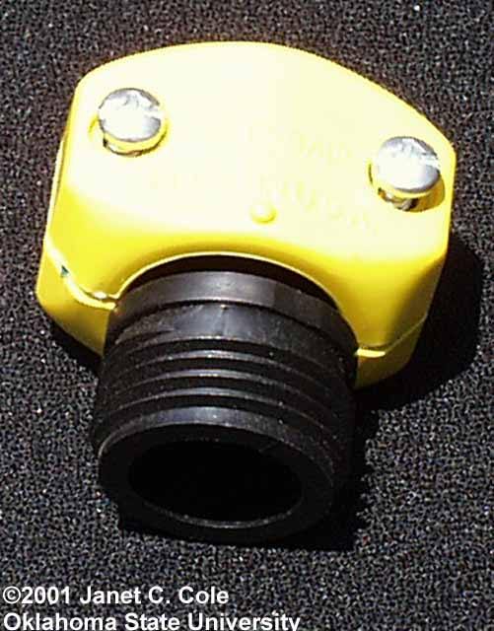
Hose-end repair fitting

Slide 38
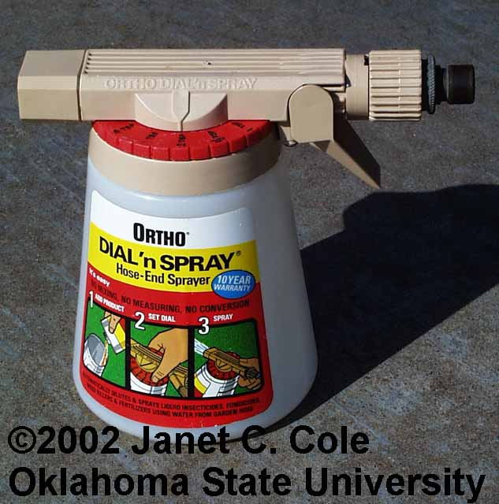
Hose-end Sprayer

Slide 39
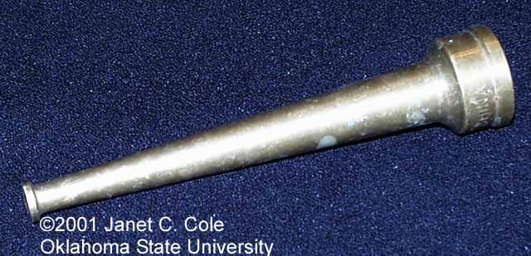
Hose-end Washer

Slide 40
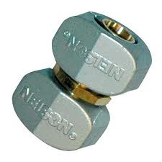
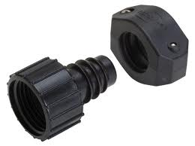
Hose repair coupling

Slide 41
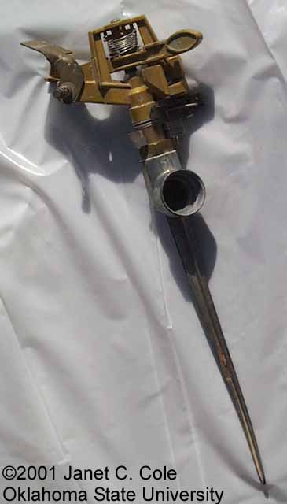
Impulse Sprinkler

Slide 42
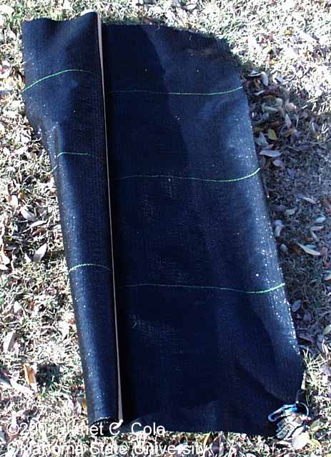
Landscape Fabric

Slide 43
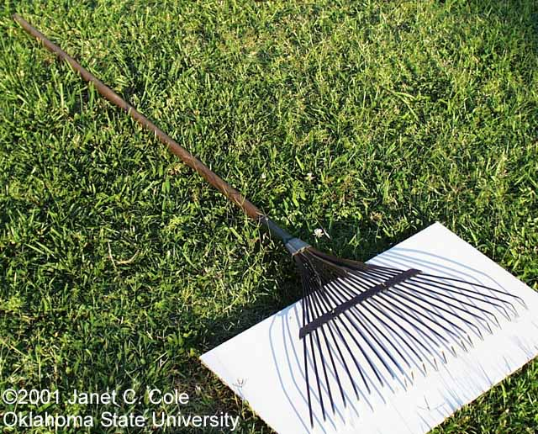
Leaf rake

Slide 44
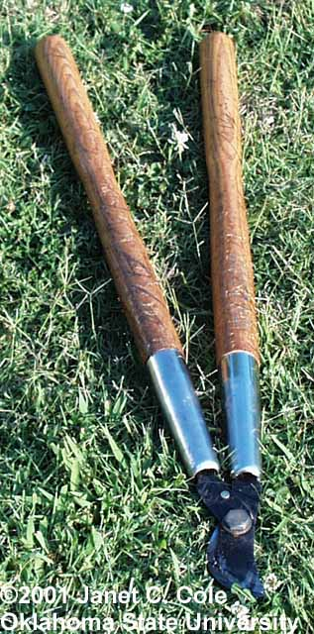
Loppers

Slide 45
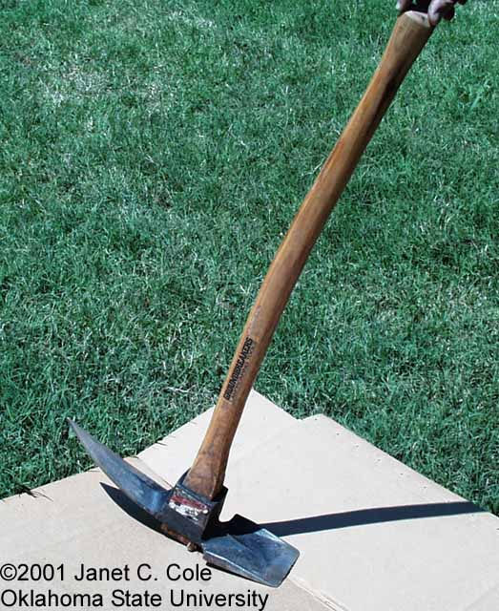
Mattock

Slide 46
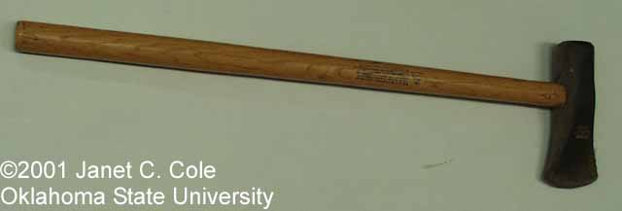
Maul

Slide 47
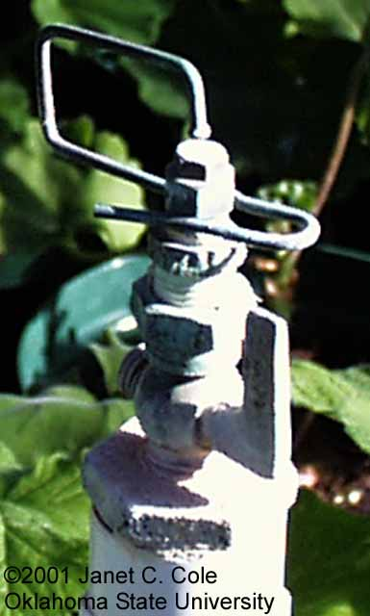
Mist nozzle

Slide 48
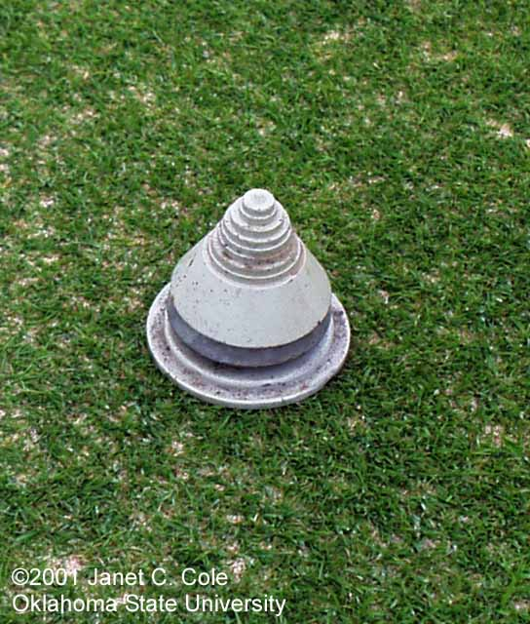
Mower blade balancer

Slide 49
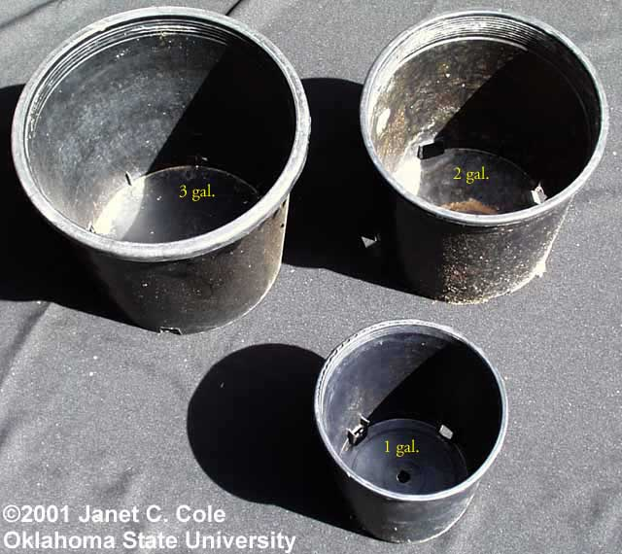
Nursery containers

Slide 50
Nursery Spade

Slide 51
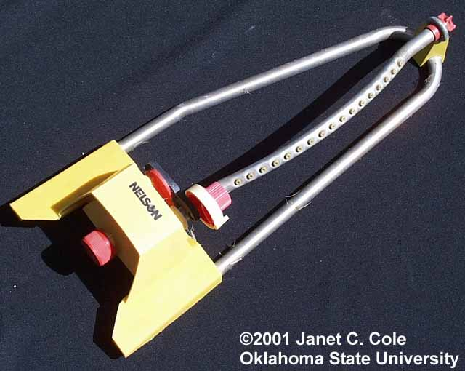
Oscillating Sprinkler

Slide 52
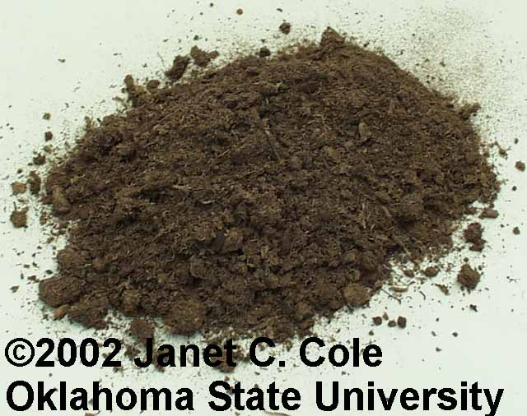
Peat Moss

Slide 53
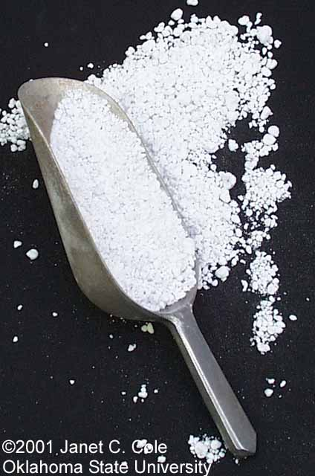
Perlite

Slide 54
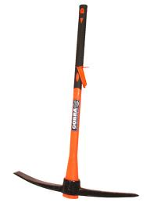
Pick Axe

Slide 55
Planting Bar

Slide 56
Pole Pruner

Slide 57
Polyethylene Film

Slide 58
Polyethylene Pipe

Slide 59
Post-Hole Digger

Slide 60
Power Blower

Slide 61
Pruning Saw

Slide 62
Power Rake

Slide 63
Reel Mower

Slide 64
Resin-coated Fertilizer

Slide 65
Respirator

Slide 66
Rotary Mower

Slide 67
Rototiller

Slide 68
Round point Shovel

Slide 69
Safety Goggles

Slide 70
Sand

Slide 71
Scoop Shovel

Slide 72
Shade Fabric

Slide 73
Sharpening Stone

Slide 74
Siphon Proportioner

Slide 75
Snow Fence

Slide 76
Soaker hose

Slide 77
Soil Sampling tube

Slide 78
Soil Auger

Slide 79
Solenoid Valve

Slide 80
Spark plug gap gauge

Slide 81
Sphagnum Moss

Slide 82
Spray Suit

Slide 83
Square point (flat) Shovel

Slide 84
String Trimmer

Slide 85
Tape measure

Slide 86
Thatch Rake

Slide 87
Timeclock

Slide 88
Topsoil

Slide 89
Tree Caliper

Slide 90
Tree Wrap

Slide 91
Trowel

Slide 92
T-Square

Slide 93
Turf Thatcher

Slide 94
Vermiculite

Slide 95
Wire Tree basket

Slide 96
Verticut Mower

Slide 97
Water Breaker

Slide 98
Watering Can

