Slide 1
Nursery Landscape
Plant ID

Slide 2
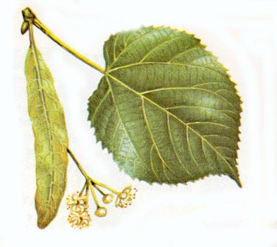
American Linden

Slide 3
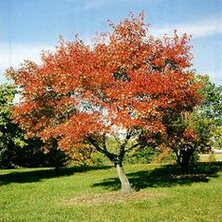
Amur Maple

Slide 4
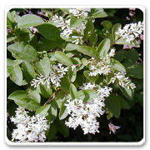
Amur Privet

Slide 5
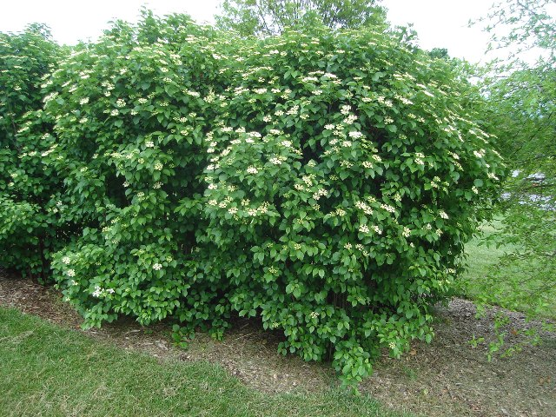
Arrow wood

Slide 6
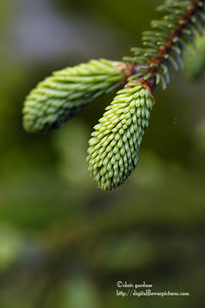
Black Hills Spruce

Slide 7
Boston Ivy

Slide 8
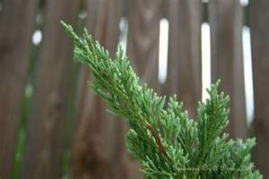
Blue Rug Juniper

Slide 9
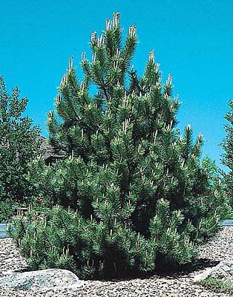
Austrian Pine

Slide 10
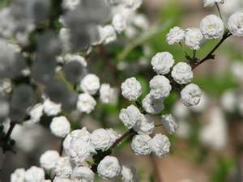
Bridal Wreath Spirea

Slide 11
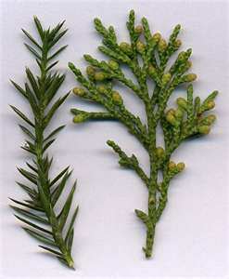
Chinese Juniper

Slide 12
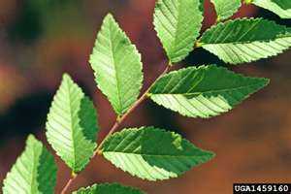
Chinese Elm

Slide 13
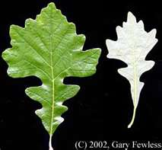
Burr Oak

Slide 14
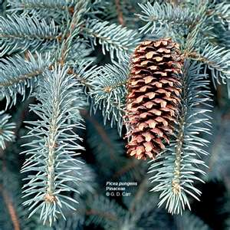
Colorado Blue Spruce

Slide 15
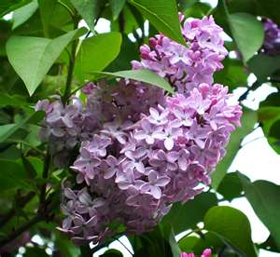
Common Lilac

Slide 16
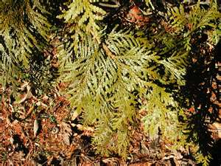
Eastern Arborvitae

Slide 17
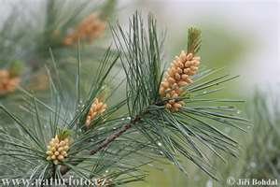
Eastern White Pine

Slide 18
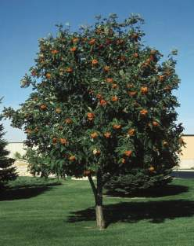
European Mountain Ash

Slide 19
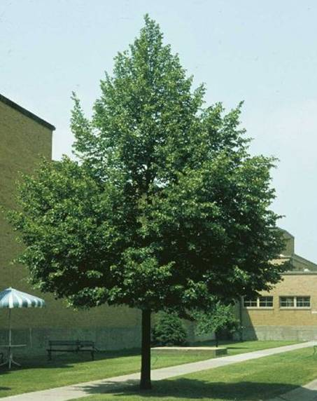
Littleaf Linden

Slide 20
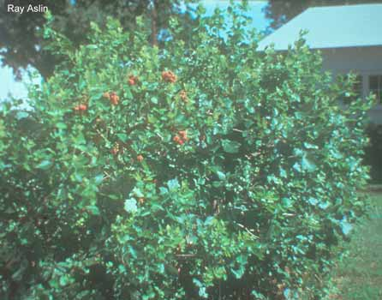
Fragrant Sumac

Slide 21
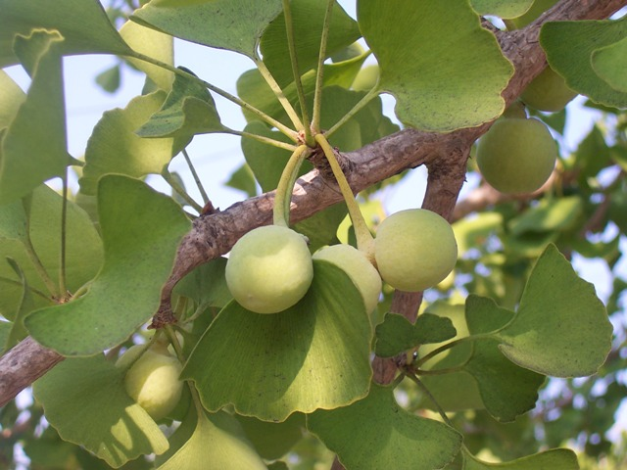
Ginkgo

Slide 22
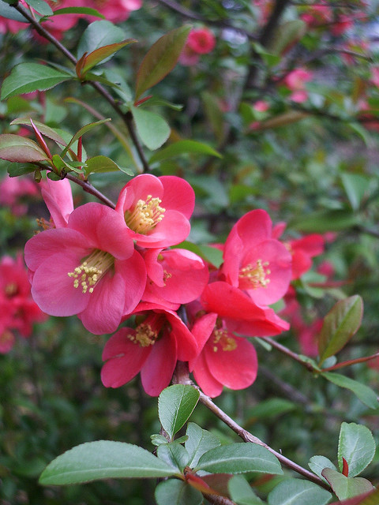
Flowering Crabapple Tree

Slide 23
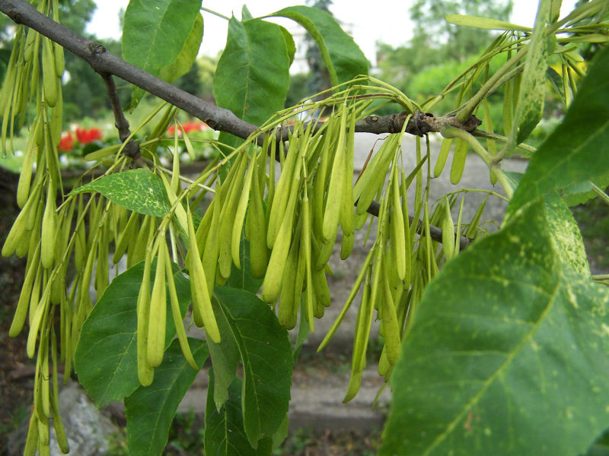
Green Ash

Slide 24
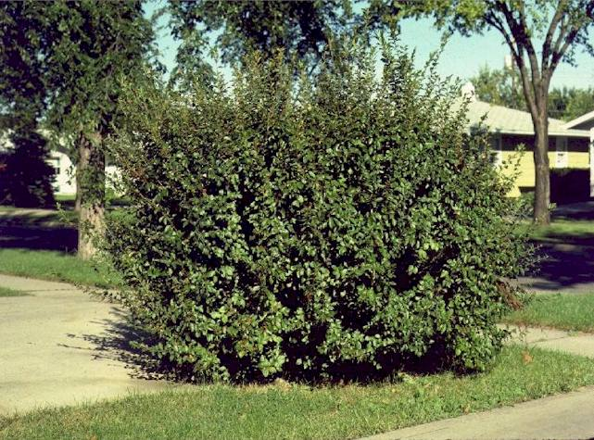
Hedge Cotoneaster

Slide 25
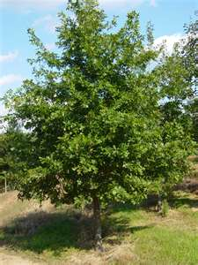
Pin Oak

Slide 26
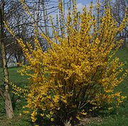
Hybrid Forsythia

Slide 27
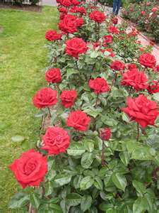
Hybrid Tea Rose

Slide 28
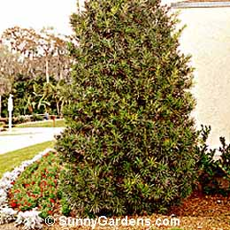
Japanese Yew

Slide 29
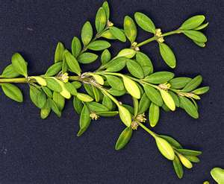
Korean Boxwood

Slide 30
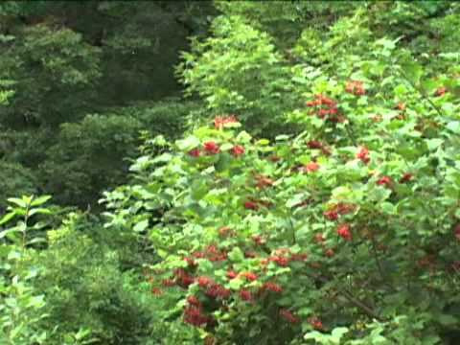
Cranberry Bush

Slide 31
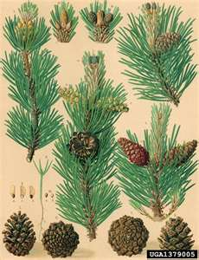
Mugo Pine

Slide 32
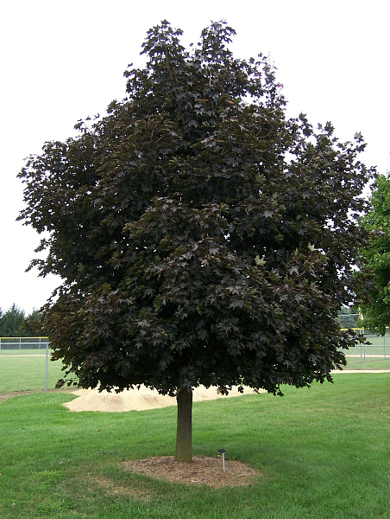
Norway Maple

Slide 33
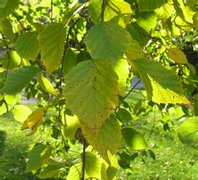
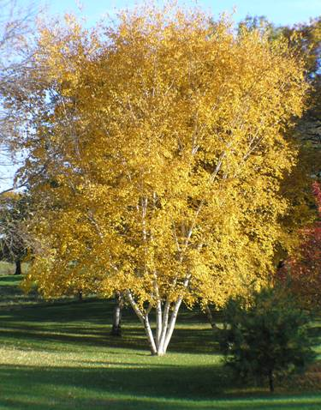
Paper Birch

Slide 34
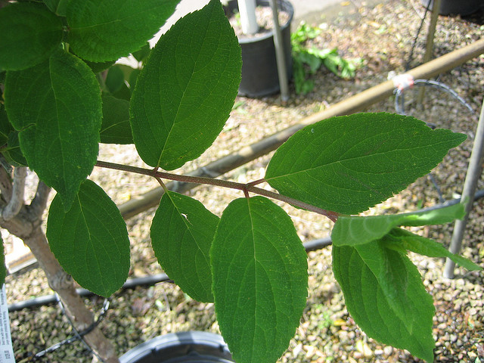
Peegee Hydrangea

Slide 35
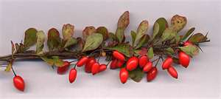
Japanese Barberry

Slide 36
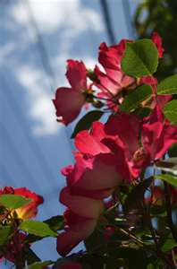
Red Dogwood

Slide 37
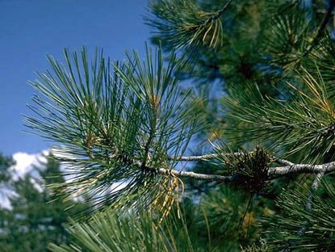
Ponderosa Pine

Slide 38
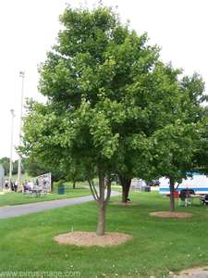
Red Maple

Slide 39
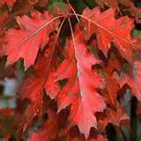
Red Oak

Slide 40
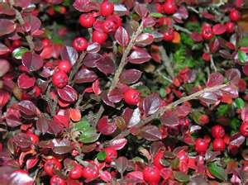
Rockspray Cotoneaster

Slide 41
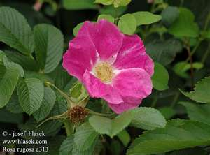
Rugosa Rose

Slide 42
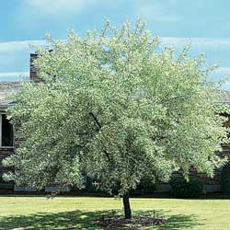
Russian Olive

Slide 43
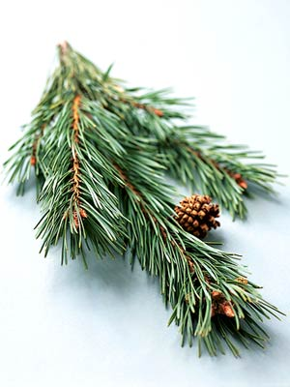
Scotch Pine

Slide 44
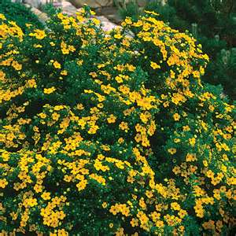
Shrubby Cinquefoil

Slide 45
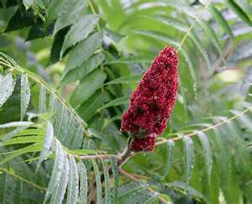
Staghorn Sumac

Slide 46
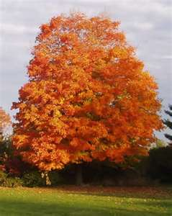
Sugar Maple

Slide 47
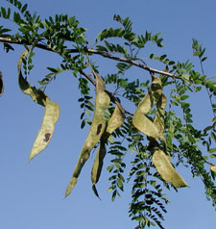
Thornless Honey Locust

Slide 48
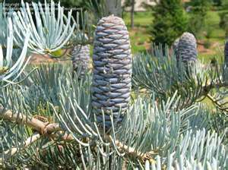
White Fir

Slide 49
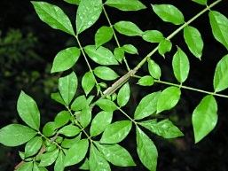
Winged Euonymus

Slide 50
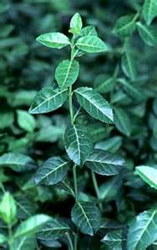
Wintercreeper

Slide 51
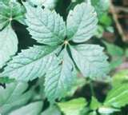
Woodbine Ivy

